Slide 1
Contacts list APP Week 6
Project name: Contacts List APP (iOS)
Student name : JunCheng Wang, Yi Wang, Junda Peng
Unit: SIT313
Student number: 216235896

Slide 2
What features we going to achieve
This is an application that runs on iOS and is used to save the phone number and name of the contact.
Users need to apply for a new account to log in to the application. You need to set your own username and password.
After logging in, the user can save the contact's name and phone number, and user can change them or delete them at anytime.
the user can choose to call or text them, or delete the contact by pressing a button.(Button name : TEL, SMS,DEL)
When we call someone, the system will record the calling history.
User can add head to every contact people.

Slide 3
What features we going to achieve
User can block any contacts
It will change color when you tap on the contacts number..

Slide 4
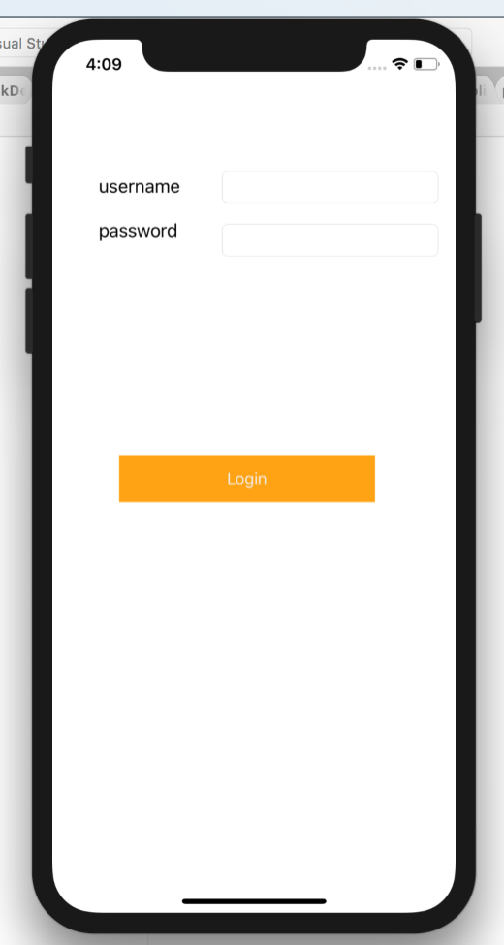
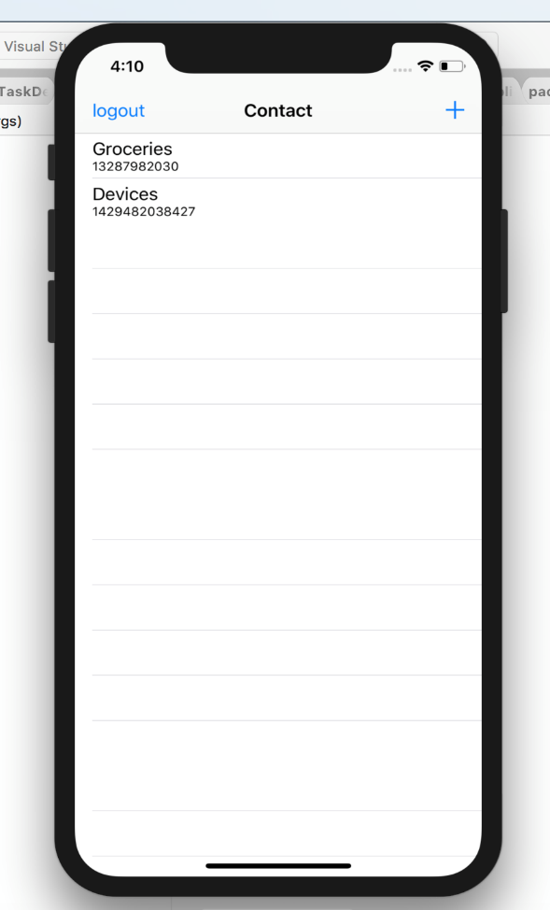
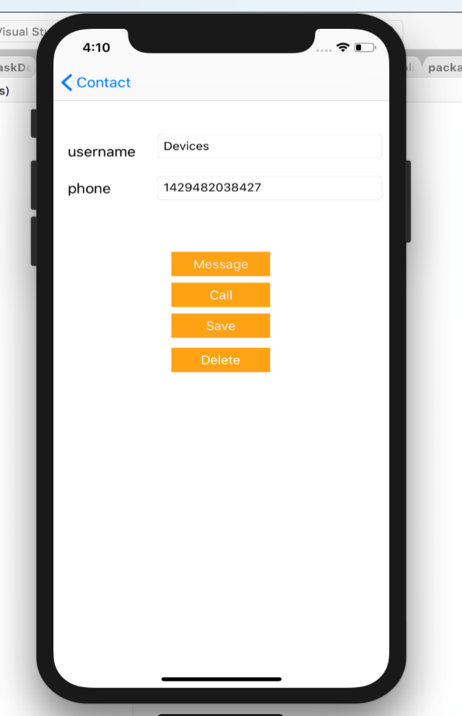
Design style

Slide 5
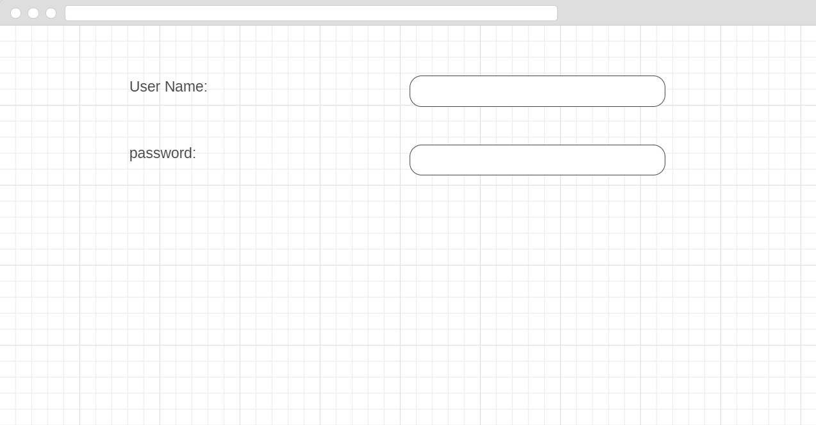
User experience

Slide 6
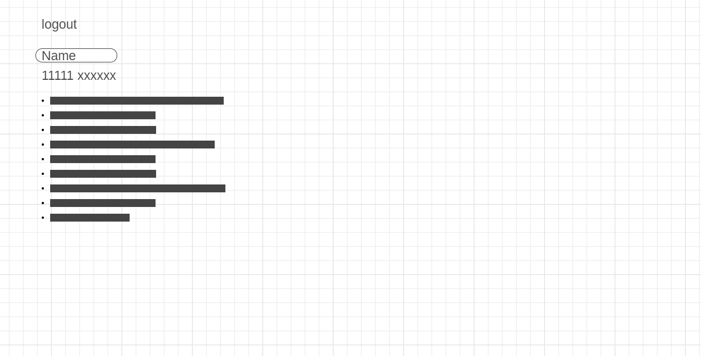
User experience

Slide 7
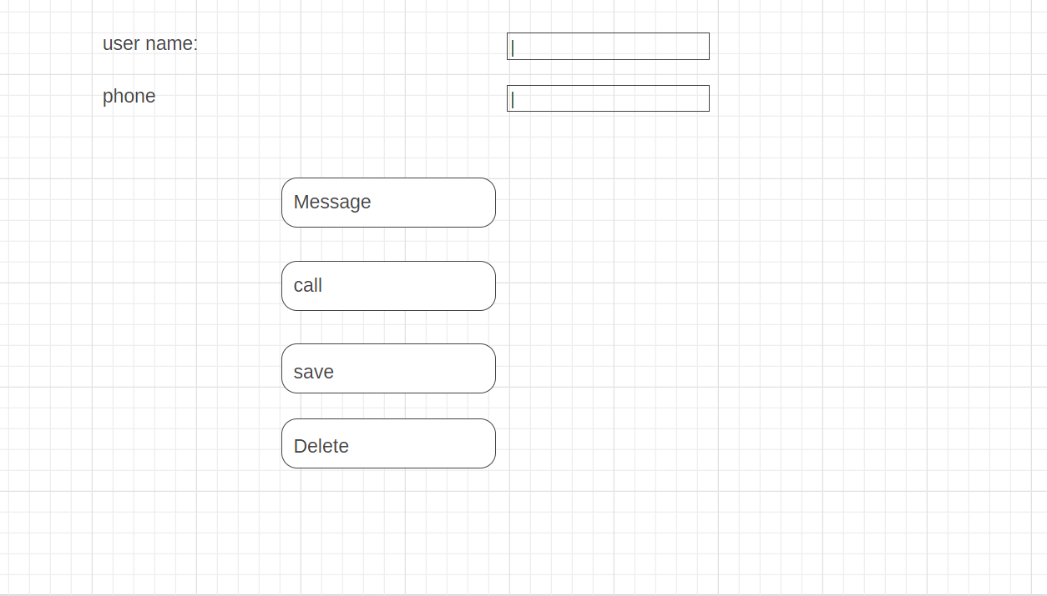
User experience

Slide 8
GITHUB
https://github.com/OwenWY/project-1-Junda-

